Slide 1
Bentham & Hooker Classification
G. Swapna
Lecturer in Botany
D.R.G Govt Degree College
Tadepalligudem

Slide 2


INTRODUCTION
Classification denotes the arrangement of a single plant or group of plants under distinct category following a system of nomenclature, and in accordance with a particular and well established plan.
Some of the earlier systems of classification of angiosperms were artificial systems, since they used only certain superficial characteristics as the basis.
 With more and more detailed study on the morphological, physiological and reproductive aspects of angiosperms, the artificial systems of classifications were replaced by the natural systems of classification.

Slide 3
Bentham & Hooker Classification
The most accepted system of classification was proposed by George Bentham and Joseph Dalton Hooker (Director of Royal Botancial Gardens) in their Genera Plantarum.
Bentham and Hooker described 97,205 species ,7569 genera of flowering plants belonging to 200 families.
They recognized 82 families in Polypetalae ,45 in Gamopetalae , 36 in Monochlamydeae , 3 in Gymnosperms and 34 in Monocotyledons.
Class Dicotyledons were subdivided into sub class polypetalae ,gamopetalae and Monochlamydeae . Each Subclasss is divided into series and orders.

Slide 4
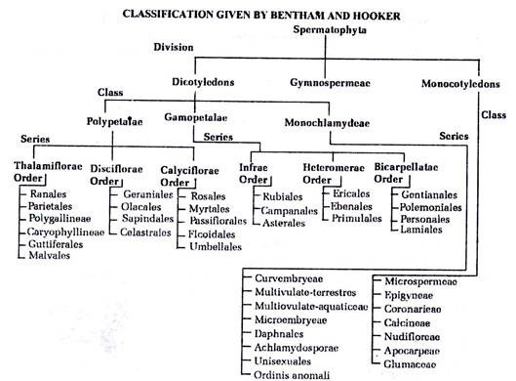

Slide 5
Bentham & Hooker Classification
Dicotyledons:
1.Two Cotyledons
2. Tap Root System
3. Reticulate Venation
4. Pentamerous or Tetramerous flowers
Class Dicotyledons is divided into 3 subclasses
1. Polypetalae: (Corolla of free petals)
1.1 Seiries Thalamiflorae : 1. Hypogynous or superior ovary
2. Thalamus is conical ,elongated or convex
(6 orders namely Ranales, Parietales, Polygalinae, Caryophyllineae, Guttiferales and Malvales)
1.2: Series Disciflorae: 1. Hypogynous ovary
2. Ring like disc below ovary
( 4 orders namely Geraniales, Celastrales, Olacales and sapindales)
1.3: Series Calyciflorae: 1. Perigynous or Epigynous flowers( 5 orders namely Rosales,Myrtales,Passiflorales,Ficoidales and Umbellales)

Slide 6
Bentham & Hooker Classification
Sub Class: Gamopetalae: Corolla of united petals)
Series I : Inferae: Inferior Ovary( 3 orders)
( Rubiales, Asterales and Campanales)
Series II : Heteromerae: Superior ovary with
more than two carpels(3 orders)
(Ericales,Primulales and Ebenales)
Series III : Bicarpellatae: Superior Bicarpellary
Ovary ( 4 orders)
(Gentianales, polymoniales, personales and Lamiales)

Slide 7
Bentham & Hooker Classification
Subclass Monochlamydeae : Single whorl of perianth divided into 7 series
Curvembryae( curved Embryo,one ovule)
Multiovulate aqualtica( aquatic plants with many ovules
Multiovulate terrestrica: Land plants with many ovules
Microembryeae( very small embryos )
Daphnales : ( Ovary with one carpel and one ovule)
Achlamydosporae: (Unilocular inferior ovary with 1-3 ovules)
Unisexuales : (Unisexual flowers )
Ordines anomali: (Families of uncertain relationhips)
Class Gymnosperms : Naked seed plants: consists of 3 families namely Gnetaceae, Coniferae and cycadaceae)

Slide 8
Bentham & Hooker Classification
Monocotyledons: Single Cotyledon, Adventitious Root System
Parallel venation, Trimerous flowers
Divided into 7 Series
Microspermae: Inferior ovary , small seeds
Epigynae: Inferior ovary , large seeds
Coronariae: petalod perianth , superior ovary
Calycineae: sepaloid perianth, superior ovary
Nudflorae: perianth absent , superior ovary
Aocarpae: free carpels
Glumaceae : small perianth scale like

Slide 9
Bentham & Hooker Classification Merits
First great Natural system of classification based on the actual living specimens
Has great practical value for identification of plants . Many countries follow this
Gymnosperms treated as individual group
Placing Dicots before Monocots
Placing Ranales at the begining of dicots
Placing polypetalae and gamopetalae before monochlamydeae and Polypetalae before gamopetalae
Placing cucurbitales in polypetalae
Gamopetalae families trace from actinomorphic to zygomorphic .
Position of heteromerae before bicarpellatae
Families with unisexual flowers placed before families with bisexual flowers in monocots
Placing Gramineae at the end of Monocots

Slide 10
Bentham & Hooker Classification Demerits
Position of Gymnosperms between Dicots and Monocots
Classification based on single and mostly artificial characters
Closely related families have been seperated and unrelated families are grouped .
Advanced families like compositae and orchidaceae considered as primitive
Arrangement of monocots is unnatural
No uniformity in the use of taxa.
Ex: Differences in dividing ploypetalae, Gymnosperms , monoclamydeae and monocots

Slide 11
Thank you

